Slide 1
Credit Card Fraud Detection Using Autoencoders In Keras
Ramya Mahesh Anusha Gangasani Ashika Anand Babu

Slide 2
Introduction
The usage of credit cards has dramatically increased these days.
As credit cards become the most popular payment method for both online and regular purchases, related fraud cases are also on the rise.
Usage of Autoencoders to detect fraudulent transactions.

Slide 3
Data
The data includes 492 fraudulent transactions out of 284,807 total transactions using European credit cards over the course of two days.
A Principal Component Analysis (PCA) has been used to reduce everything except the time and amount due to privacy concerns.
We can also consider that there are only 0.17% of fraudulent transactions in our given dataset and we are able to obtain over ~70% accuracy using our model for predicting credit card fraud occurrence.

Slide 4
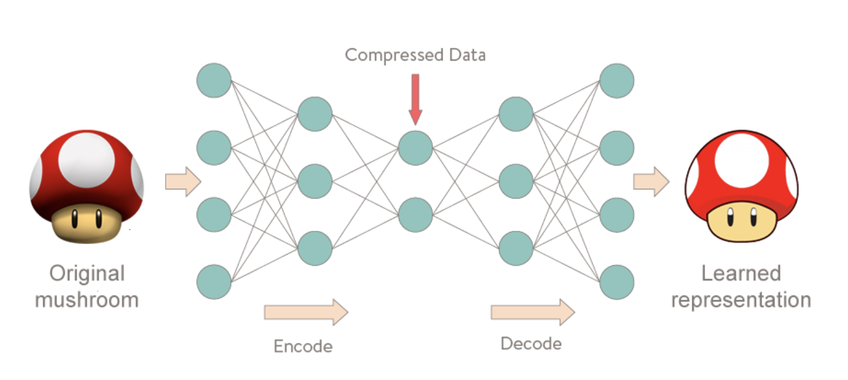
Autoencoders
Autoencoders can seem quite bizarre at first. The job of those models is to predict the input, given that same input.
Using Reconstruction Error
Encoder and KNN

Slide 5
Implementation
Reconstruction error
Preparing the data
Building the model
Evaluation
Reconstruction error without fraud
Precision vs Recall
Prediction

Slide 6
Experiment & Results
Choosing autoencoding since we need to predict the same type of record - fraud
Number of Epochs - we set the epochs at 50 as the accuracy does not seem to increase later and loss reduces around 10th epoch and remains constant.
Batch Size - Tested with 15, 20, 100. Set to 15 as accuracy was higher
Activation function - Tested with relu, sigmoid and tanh. With sigmoid in the first layer of decoder and encoder, the loss was very high and the model was not stable. Relu improved accuracy and provided better results.

Slide 7
Conclusion
The simple deep autoencoder in Keras that has been developed can reconstruct what non-fraudulent transactions look like.
The large area under the Recall vs Precision curve represents both high recall and high precision, with high precision associated with low false positive rates and high recall associated with low false negative rates.

Slide 8
Thank You Github : https://github.com/gangasani-anusha/RL-FinalProject

